Slide 1

SPACE ALLOCATION TECHNIQUES
Design Optimization Toolset (DOTS)
Nirvik Saha, Ph.D., Post-Doctoral Fellow at Rensselaer Polytechnic Institute
Dennis Shelden, Ph.D., Director of Center for Architecture Science & Ecology, Rensselaer Polytechnic Institute
John Haymaker, AIA, Ph.D., Director of Research at Perkins and Will

Slide 2
Space Allocation Techniques (SAT)
Framework
Integrate
Connected Methods
General class of constrained-problems
NP complete problem
5!=120, 10! = 3.6M+; 14!=87B+; 15!=1.3076744e+12
Floor
Site
City-Blocks
Employed in numerous design processes, across scales

Slide 3
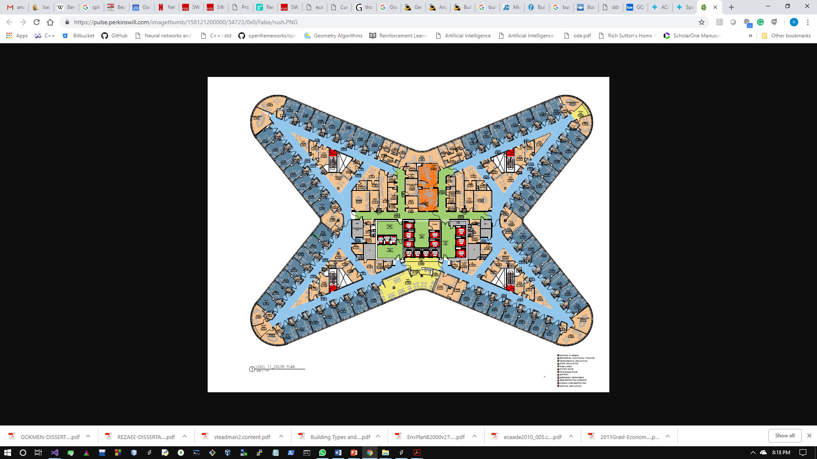
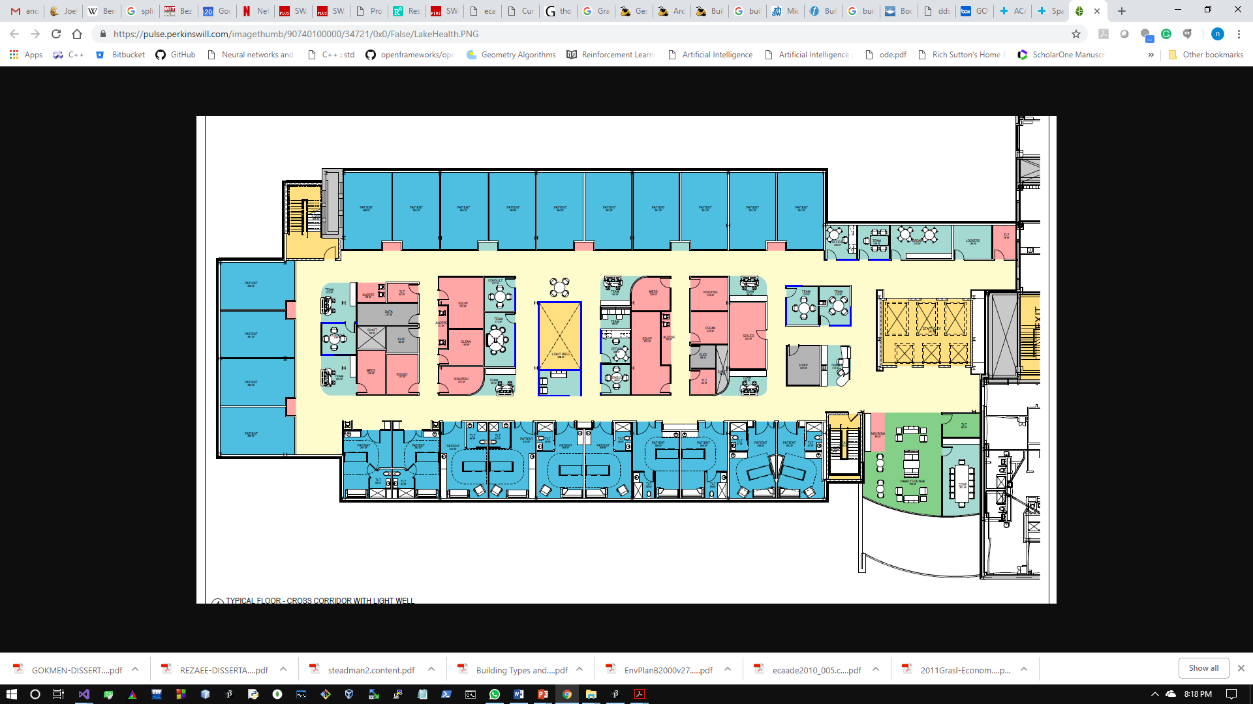
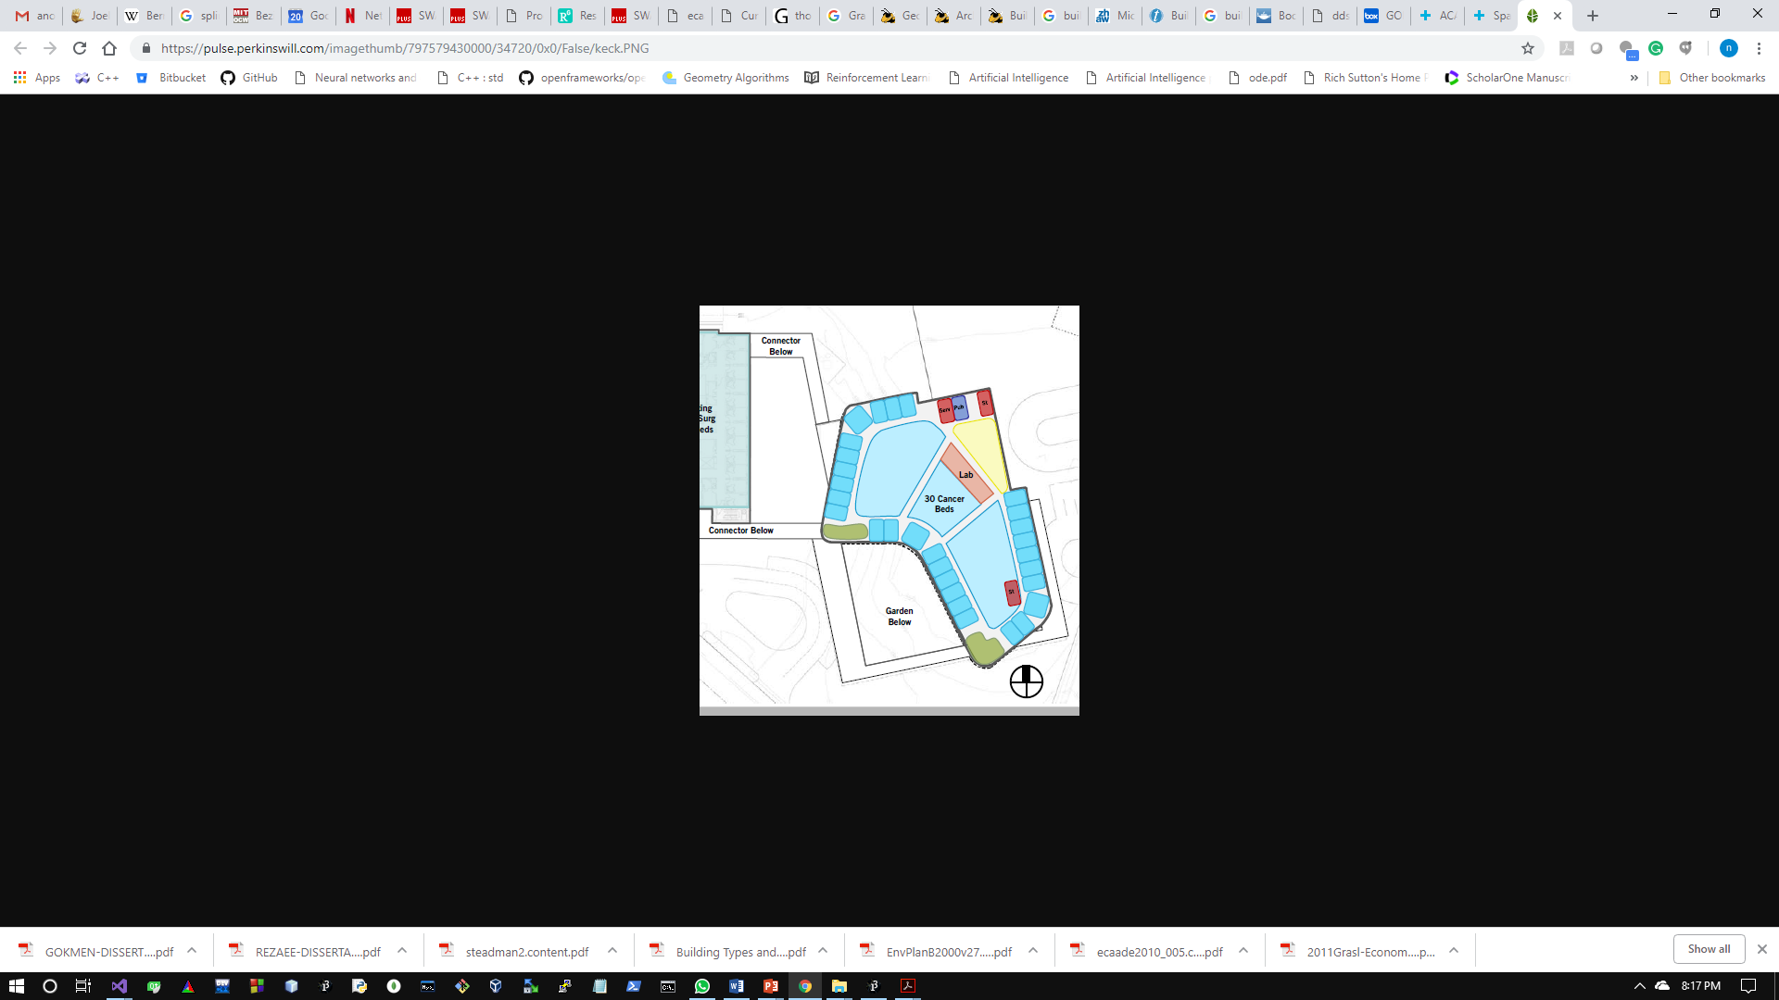
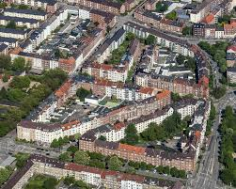
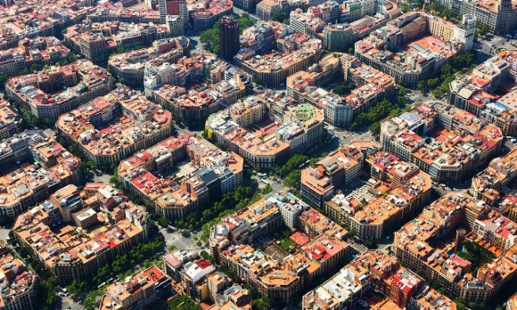
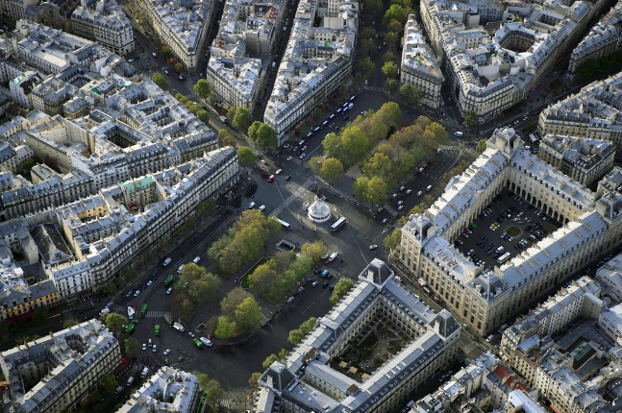
Hypotheses
Collection of Patterns, Generalize – form / task
Geometric forms
Optimization techniques
Algebraic forms + Reinforcement Learning
Generalize geometric formulation
Simulate Data
practically impossible to collect data before design
Patterns in organization of spaces: i) along the periphery ii) subdivision of internal region.
Building floor plans
Satellite images of Barcelona, Paris, and Berlin

Slide 4
Integrated data structures
Connected Methods
Framework
SAT
Optimize
SAT Generate
Models (M_{0-n})
Design problems
Geometric Forms
Organize relationships
Model-1
Model-2
SAP
workflow
workflow
Linked- multiple models
Embedded structures in framework
Explicit design process
Exploration
Semi-automation

Slide 5
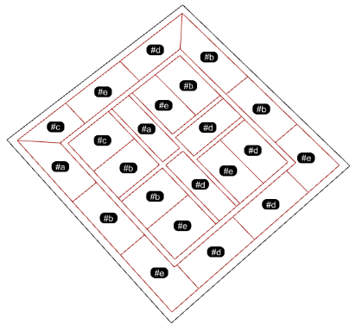
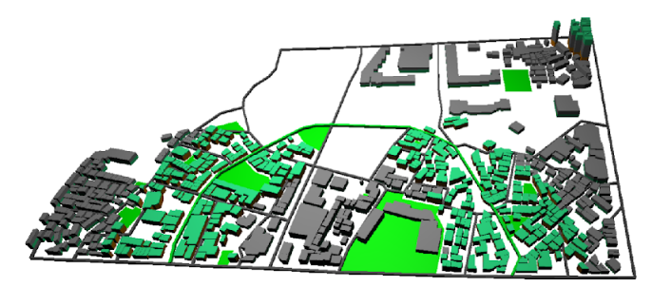
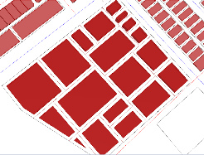
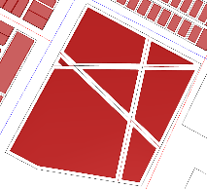
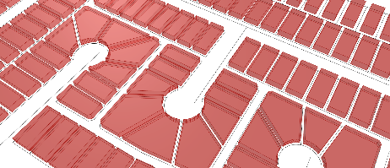
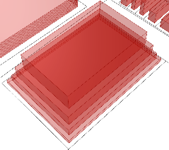
Reinforcement Learning
Environment
Agent
State
Action
Reward
Environment
Action-Value Function
Policy
Q-Learning
Methods
s
Initial State
P
Policy
a
Action
p
Probability
Reward
r
s’
New State
Floor Plans
Site Plan & massing
Space-Activity Networks of City-blocks

Slide 6
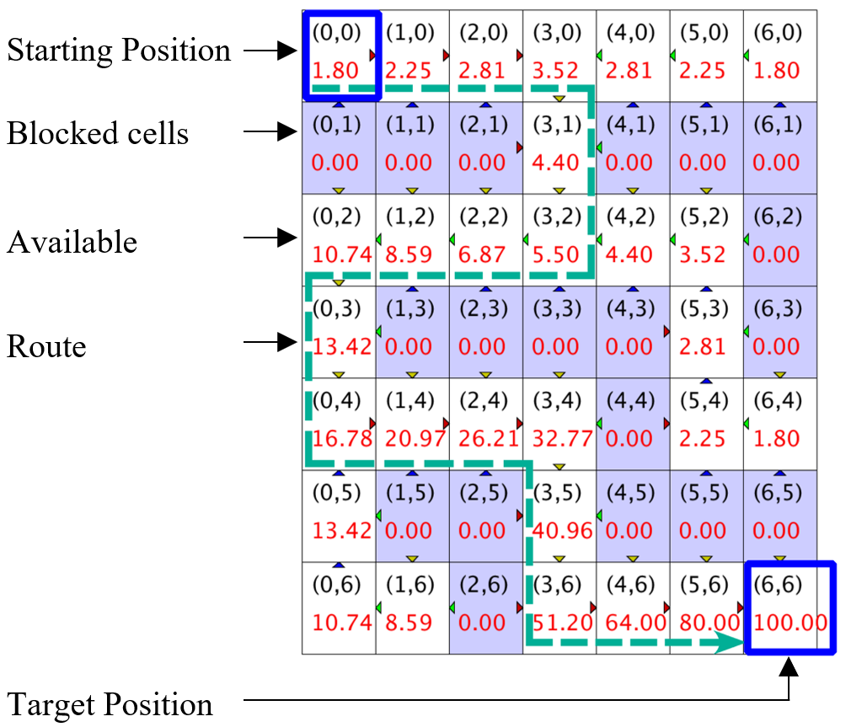
Illustration of Reinforcement Learning
Initialize Q matrix with elements set at 0
States (x,y) | 0 | 1 | …6
0 | 0.0 | 0.0 | 0.0
1 | 0.0 | 0.0 | 0.0
…6 | 0.0 | 0.0 | 100.00
Discounted rewards Reward: R(s’,a) = R(s,a)+∑_{(i=1)}^{T}γ^{(i-1)}R_{i} (where 0<γ<1, let γ=0.8)
Set of states s_{i}: {(0,0, (0,1), (0,2), …, (6,5), (6,6)}
Set of actions a_{i}: {up, down, left, right}
Updated Q matrix
States (x,y) | 0 | 1 | 2 | 3 | 4 | 5 | 6
0 | 1.80 | 2.25 | 2.81 | 3.52 | 2.81 | 2.25 | 1.80
1 | 0.00 | 0.00 | 0.00 | 4.40 | 0.00 | 0.00 | 0.00
2 | 10.74 | 8.59 | 6.89 | 5.50 | 4.40 | 3.52 | 0.00
3 | 13.42 | 0.00 | 0.00 | 0.00 | 0.00 | 2.81 | 0.00
4 | 16.78 | 20.79 | 20.21 | 32.71 | 0.00 | 2.25 | 1.80
5 | 13.42 | 0.00 | 0.00 | 40.96 | 0.00 | 0.00 | 0.00
6 | 10.74 | 8.59 | 0.00 | 51.20 | 64.00 | 80.0 | 100.00

Slide 7
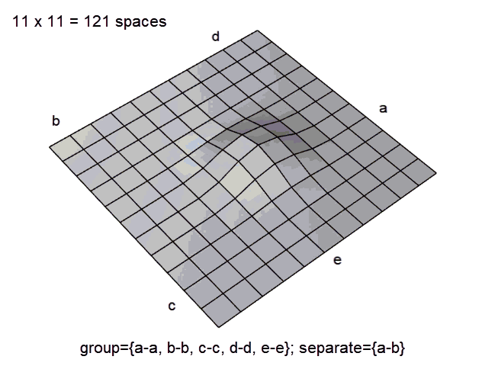
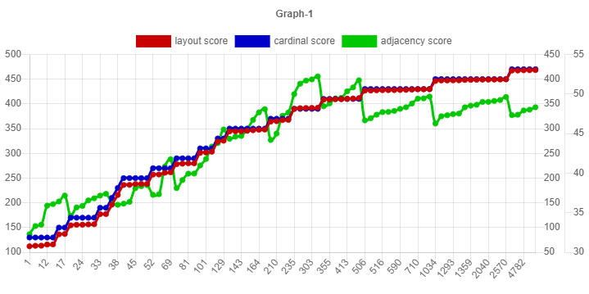
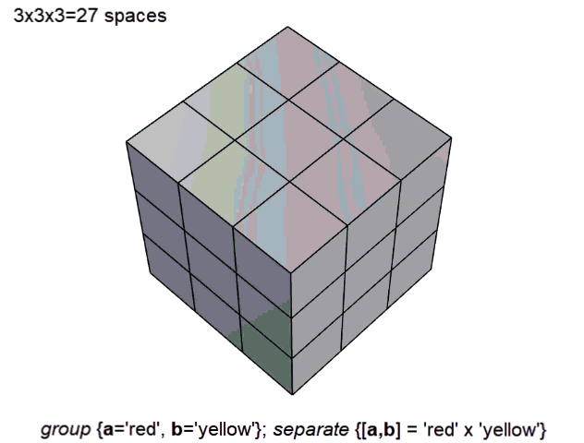
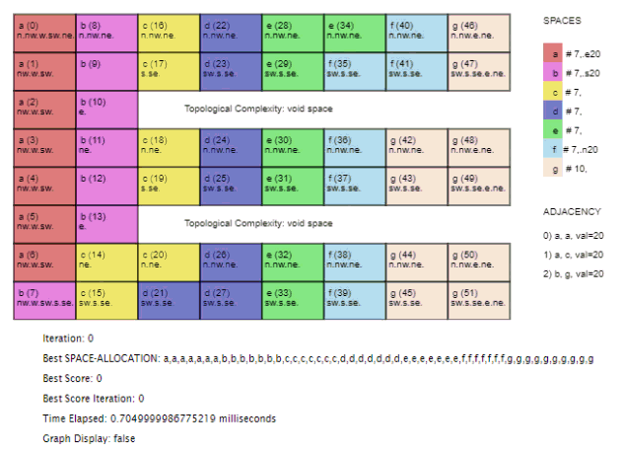
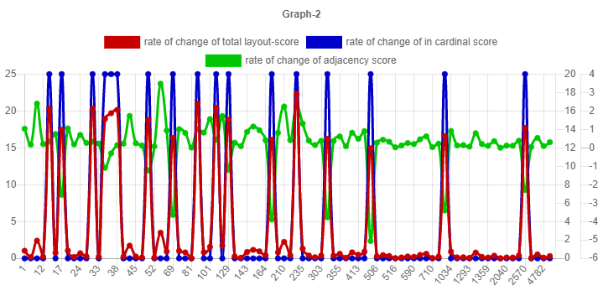
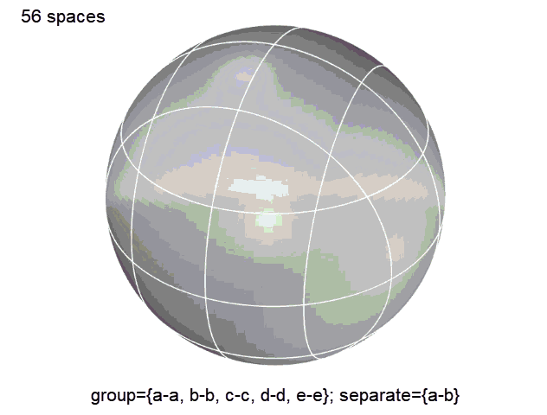
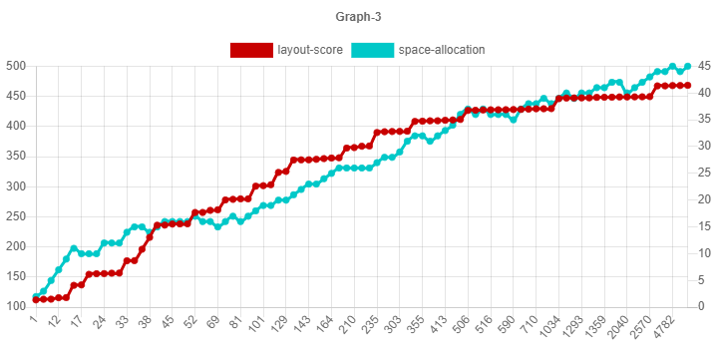
Problem Formulation
@ https://dots-ai.herokuapp.com/
Constraints in a nutshell
Adjacency
a-a,
a-c,
b-g
Orientation
a-> east
b-> south,
f-> north
Graph 1 :
layout-score
orientation-score
adjacency-score
Reinforcement Learning
Graph 2 : rate of change:
layout-score
orientation-score
adjacency-score
Graph 3 :
layout-score
change in layout

Slide 8
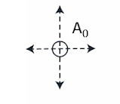
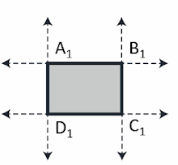
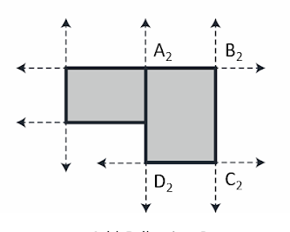
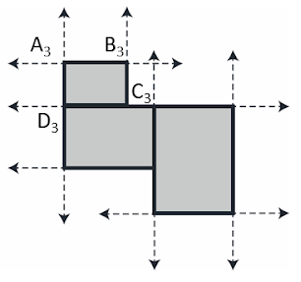

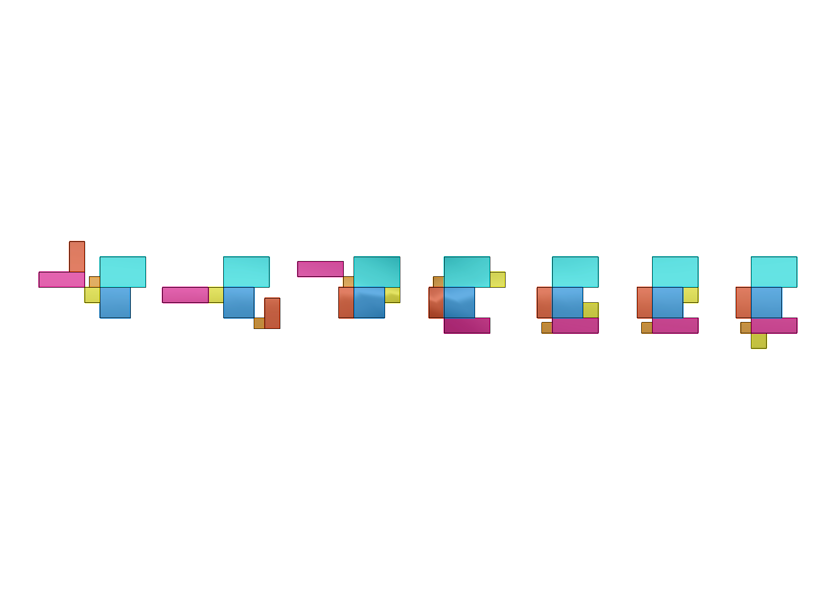
Formulation 1
Name | Length | Width | F1 | F3 | F5
F0 | 100 | 100 | 10
F1 | 70 | 70 |  | 10
F2 | 100 | 200 |  | 10
F3 | 300 | 100 |  |  | 10
F4 | 300 | 200 |  |  | 10
F5 | 200 | 200
Growing a configuration:
Constraints
f0
f1
McMC Iterations
f2
f3
f4
f5
f5
f0
f0
f0
f0
f0
f2
f0
f4
f0
Representation
f3
f5
f4
f4
f5
f3
f5
f5
f5
f4
f3
f1
f3
f2
f1
f4
f1
f2
f1
f2
f4
f2
f3
f1
f1
f2
f3
f3
f4
f5
f2
f1
Backtracking
f5
f0
f0
f5
f0
f0
f0
Missing Adjacency Relation
f3
f3
f5
f1
f1
Achieved
f1
f1
f1
f3
f1
f3
f1, f3, 8
f3, f5, 4
f0, f1, 7
f1, f3, 8
f3, f5, 4
f0, f1, 7
f3, f5, 4
f0, f1, 7
f1, f3, 8
f0, f1, 7
f0, f1, 7
No Error

Slide 9
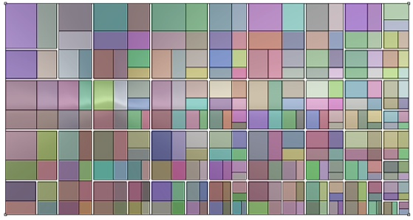
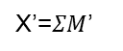
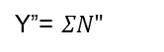
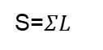

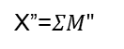
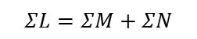
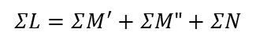
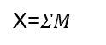
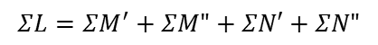
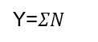
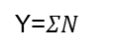
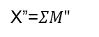
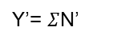
Formulation 2
Equivalence between requirements and the geometric operations
Generate Circulation
Binary Partition
Requirements - partitions
Geometric Equivalence
Area=$ΣL$
L={a,b,c,d}
S=$ΣL$
L={a,b,c,d}
$$ΣL=ΣM+ΣN$$
M={a,b}
N={c,d}
Y=$ΣN$
X=$ΣM$
S=$ΣL$
L={a,b,c,d}
M={a,b}
N={c,d}
X’=$ΣM$’
Y=$ΣN$
$$ΣL=ΣM^{′}+ΣM"+ΣN$$
M’={a}
M”={b}
X”=$ΣM"$
S=$ΣL$
L={a,b,c,d}
Y’= $Σ$N’
$$ΣL=ΣM^{′}+ΣM"+ΣN′+ΣN"$$
M={a,b}
N={c,d}
X’=$ΣM$’
M’={a}
M”={b}
N’={c}
N”={d}
X”=$ΣM"$
Y”= $ΣN"$
S=$ΣL$
very large layouts

Slide 10
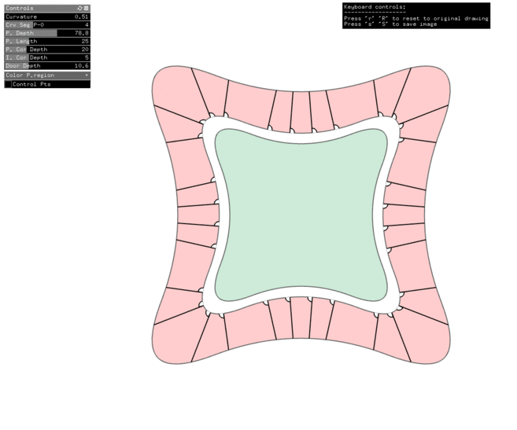
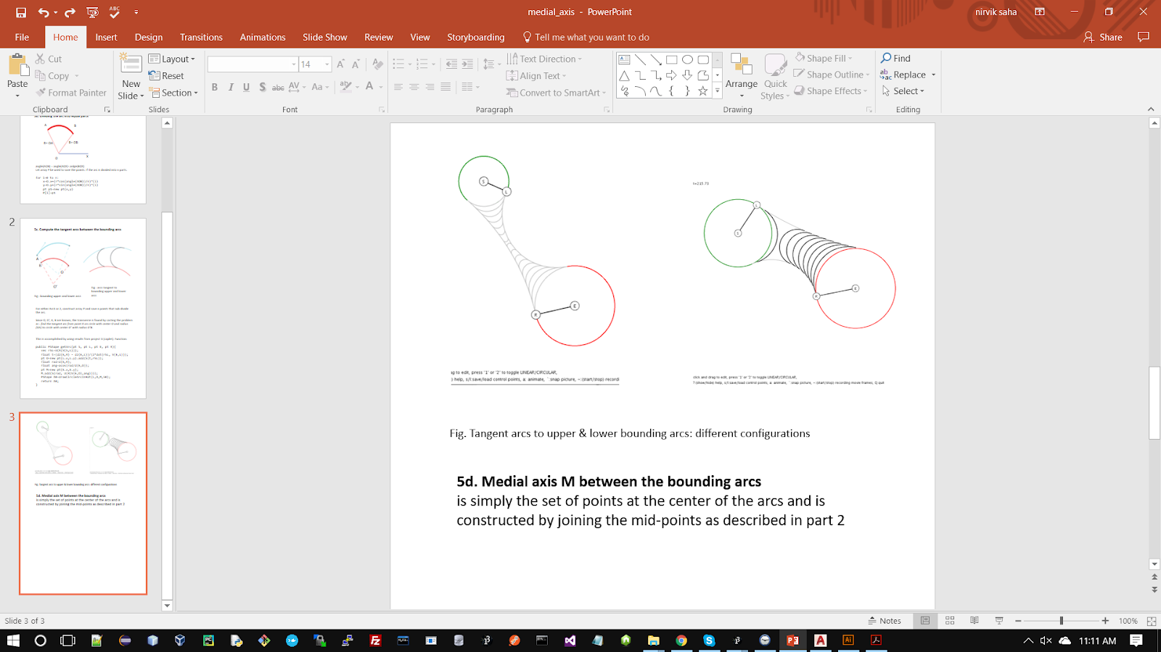
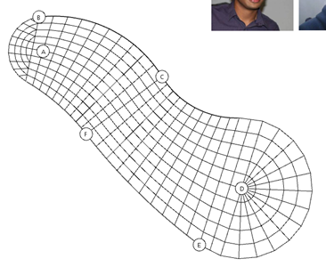
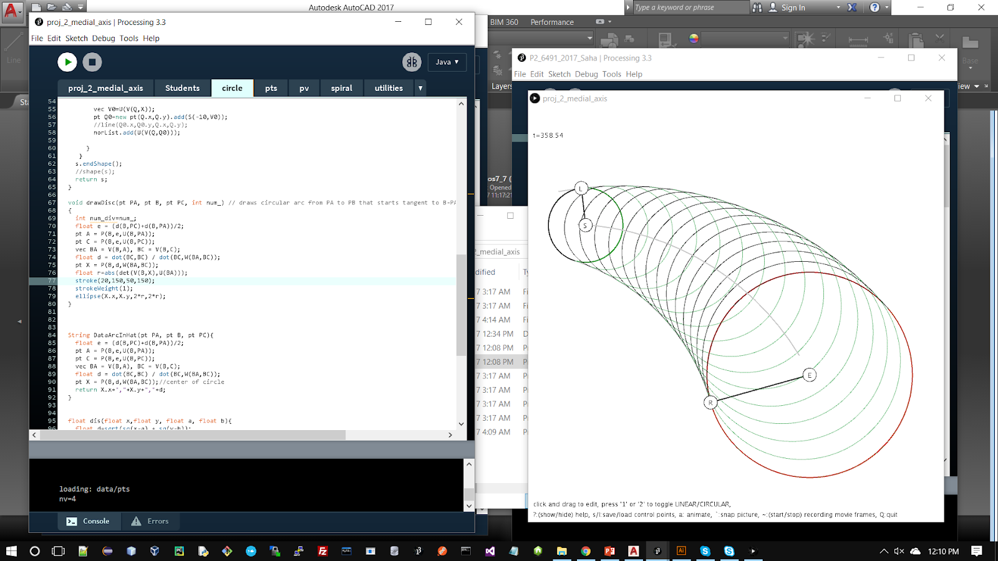
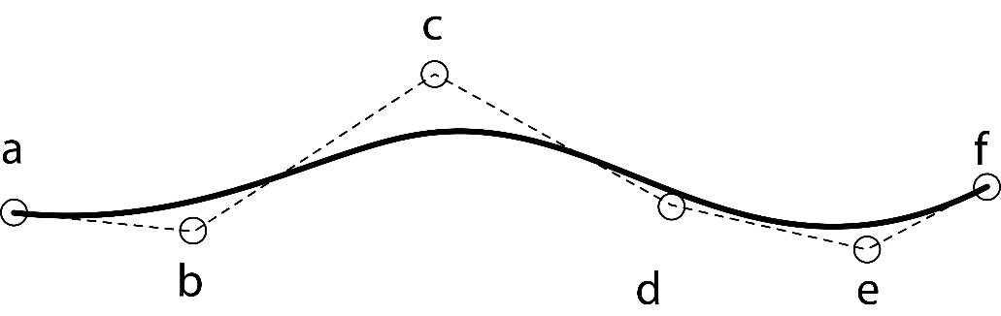
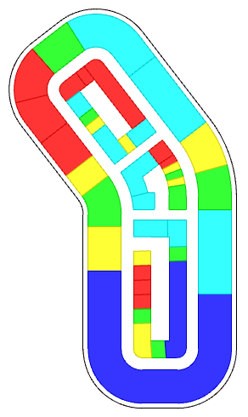
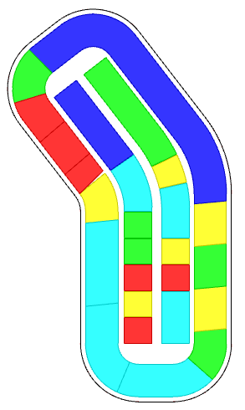
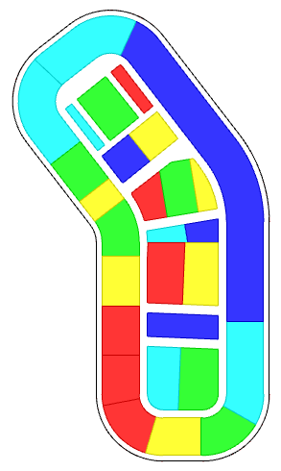
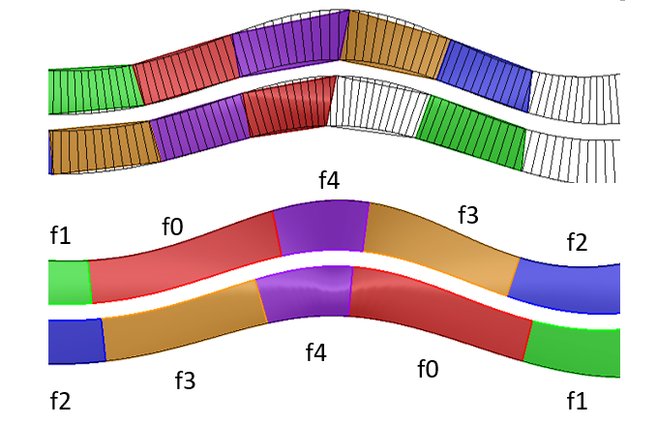
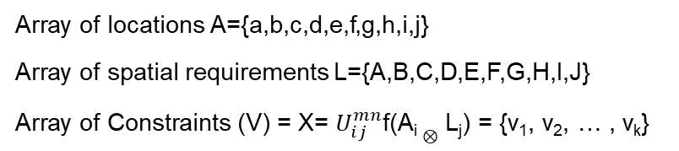
Formulation 3
Using Transformations & Discretization of region in a curve
Array of locations A={a,b,c,d,e,f,g,h,i,j}
Array of spatial requirements L={A,B,C,D,E,F,G,H,I,J}
Array of Constraints (V) = X= $U_{ⅈj}^{mn}$f(A_{i} $⊗$ L_{j}) = {v₁, v₂, … , v_{k}}
Seamless transformations:
Bernstein polynomial basis recurrence relation
f(t) = Σ_{i=0}^{n} (^{n}C_{i}) (1-t)^{n-i} t^{i}
spaces | Area | Depth | Number | rgb | f0 | f1 | f2 | f3 | f4
f0 | 1000 | 100 | 2 |  |  |  |  | 50
f1 | 300 | 100 | 2 |  |  | -50
f2 | 500 | 100 | 2 |  |  |  | -50
f3 | 850 | 100 | 2 |  |  |  |  | 50
f4 | 350 | 100 | 2 |  |  |  |  |  | 100
Discretization:
Medial Axis Transform
Combined Patterns
peripheral
longitudinal
transverse

Slide 11
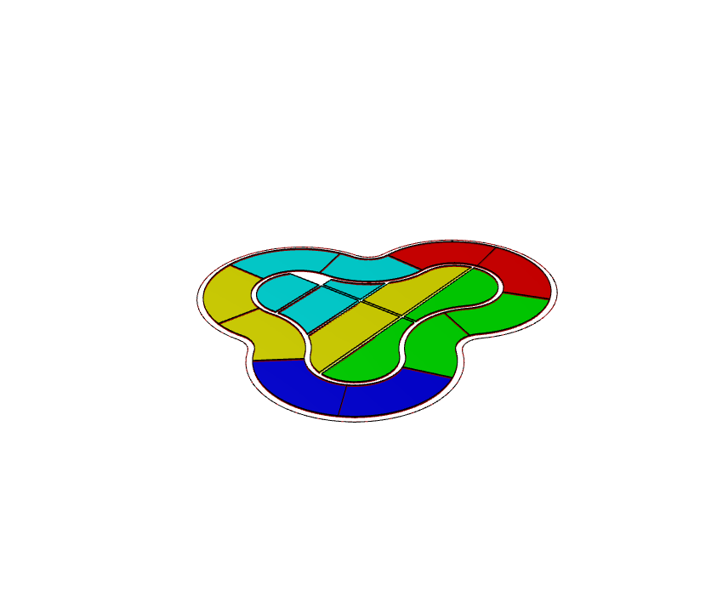
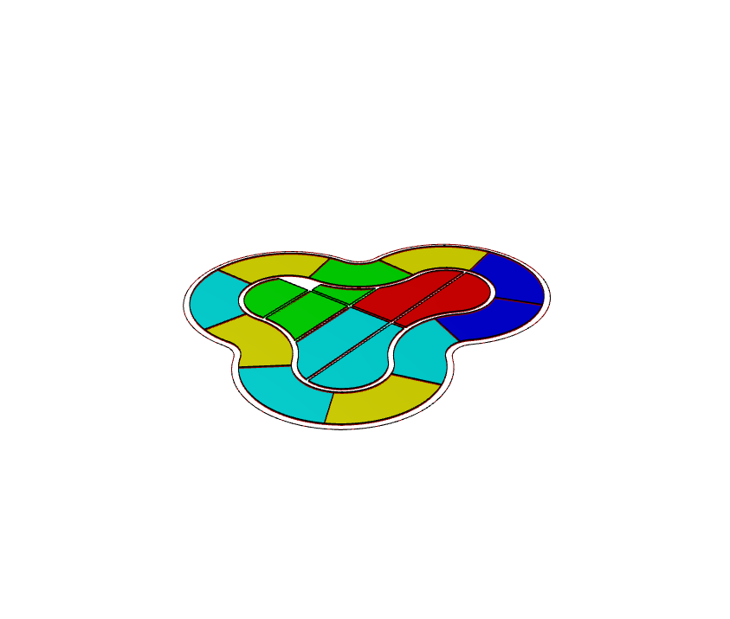



Optimization Problem Formulation
Geometry Inputs
Name | Key | Area |  | Number
name_A | a | 500 |  | 2
name_B | b | 500 |  | 4
name_C | c | 1500 |  | 2
name_D | d | 750 |  | 4
name_E | e | 2000 |  | 5
Adjacency Inputs
Name | Key | a | b | c | d | e
name_A | a | 100 |  | 10
name_B | b |  | 10
name_C | c | 10
name_D | d |  |  |  | -50
name_E | e
Attract:
a-a
a-c
b-b
e-e
Repel:
d-d
Inputs
Initial Configuration
Optimization
Updated result

Slide 12












Framework
Symbol
Description
Illustration
Symbol
Description
Illustration
Plots rows of spaces based on geometry & adjacency given an open curve
Generates equal partition of spaces along the periphery of a given curve.
Creates the circulation for the partitioned region
Plots two rows of both geometry & adjacency for an open curve
Plots a 2D grid of spaces and organizes the activities
Plots geometry & adjacency for a given closed curve
Split a Curve into a core and quadrants
Partitions a given region into spaces and organizes the activities
Generates exact geometry of spaces by partitioning a given curve

Slide 13














Framework
Symbol
Description
Illustration
Symbol
Description
Illustration
Given a site, generates parcels along the periphery of the region
Basic Tower: Extrusion based on FSR, setbacks, etc
Sub-divides the region into parcels - for massing
Extrusion based on FSR, setbacks, step-backs, variable heights, etc.
Creates the circulation for the partitioned region
Generates courtyard typology based on fsr, setback. etc
Generates internal partitions and eliminates a region from the parcels
Selective extrusion of the podium
Given an internal polygon, generates parcels that correspond to the sides
Large-scale FSR allocation from streets for any given parcel geometry
Given a site and circulation, generates the parcels for massing or subsequent operations

Slide 14









Framework
Symbol
Description
Illustration
Symbol
Description
Illustration
Allocate footprints in a curve for Site Feasibility studies
Generate grid-circulation in a region
Allocate activities to floor plates vertically in buildings for Site Feasibility studies
Generate parcels to accept Fsr distribution
Organizes the activities to index of spaces for any given geometry of spaces - multiple sources (only optimization).
b,d,a,e,e,d,
c,a,b,c,b
Fsr distribution across Parcels from >1 points
Fsr distribution across parcels from curves and points

Slide 15






Semi-automation
1. Change constraints during the process
2. Change geometry
Name | Key | a | b | c | d | e
name_A | a | -100
name_B | b
name_C | c
name_D | d
name_E | e
Repel:
a-a
Generalize / flexibility
Name | Key | a | b | c | d | e
name_A | a | 100 |  | 10
name_B | b
name_C | c | 10
name_D | d
name_E | e
Attract:
a-a
a-c
3. Memory functions
Name | Key | a | b | c | d | e
name_A | a | 100 |  | 10
name_B | b |  | 10
name_C | c | 10
name_D | d
name_E | e
Attract:
a-a
a-c
b-b
Attract:
a-a
a-c
b-b
Repel:
a-a
Name | Key | a | b | c | d | e
name_A | a | 100 |  | 10
name_B | b |  | 10
name_C | c | 10
name_D | d |  |  |  | -50
name_E | e

Slide 16








Framework
Result of operations
start
DOTS notation
end

Slide 17









Space Planning
DOTS notation
Explicit Design Process
Topological variations
DOTS notation
<4 threads>
<4 threads>
List of requirements: Neuro Patient Room, Patient Room, Ada Patient Room, Conference, Training Room, Neuro Monitor Room, Reading, Interview Room, Ptot Therapy, EVS, Consult, Seating Area, Family Lounge, Staff Lounge, Workstation, Meds, Clean Supplies, Staircase, Nour, EVS, Linen, Shared Office, Public Tlt, IS, Dir Office, Trash Recycle, Pts, Elec, Treatment Room, Respite Room, Food Gallery

Slide 18




Site Feasibility Study
DOTS notation
Building Details, proximity / distance matrix
Name & Identification |  | Geometric Constraints |  |  |  | Distance Constraints
Name | Key | Number | Footprint Area | Fsr | Ratio | a | b | c | Color
name_A | a | 2 | 100 | 0.5 | 0.75 | 12 | 12 | 5
name_B | b | 1 | 100 | 0.2 | 1.25 | 5
name_C | c | 3 | 100 | 0.2 | 0.75 | 5 |  | 12
name_D | d | 2 | 100 | 0.35 | 1.25 | 5
The distance matrix performs is similar to the adjacency matrix, unspecified values are assumed as 0
Activity Details
Identifier |  | Location Constraints |  | Building Identifier
Name | Key | Percentage | Height | Parent | Parent | Parent | Parent | Color
name_P | p | 20 | 50 | a | b | c | d
name_Q | q | 70 |  | a | c
name_R | r | 10 | 200 | a | b
Since the activity is allocated after placing the buildings, the parents are used to identify the building.

Slide 19




Large-scale design problem
Nodes: building, squares, parks, etc.
Edges: Streets, roads, pedestrian path, etc.
Places
Node type: GCN
Node type: NCN
Node type: RCN
Node type: EVAC
Grid
Network
Circulation
Buildings / Space Allocation
from region enclosed by a curve
Connect nodes with edges
Edges- TYPES of geometry of streets, roads
centrality, dispersal, betweenness, intersections
Live
Shop, recreate
Work
Exit
Edge type: Green
Edge type: Neutral path
Edge type: Road
Edge type: Intersection
Edge type: MST path
Edge type: Evacuation
Connectivity,
Interactions

Slide 20



Networks of graphs & nodes
Constraints: cost functions for centrality, betweenness, attraction, proximity between nodes & FAR of each
web-based solver
Interaction between Nodes
Node type: GCN
Node type: NCN
Node type: RCN
Node type: EVAC
Live
Shop, recreate
Work
Exit
Interaction between sets of nodes
Edge type: Green
Edge type: Neutral path
Edge type: Road
Edge type: Intersection
Edge type: MST path
Edge type: Evacuation

Slide 21










Interoperability for designers
Interoperability: Rhino - cloud (web app) - Dynamo
Cloud - mLab, Heroku (web)
https://dots-web.herokuapp.com/
Process Pipeline
Rhino3d, Grasshopper
Dynamo/Revit (BIM)
https://github.com/nirvik00/DOTS
https://github.com/nirvik00/DotsDynamoDll
User’s Software

Slide 22


Collaboration with Analysis Teams
Relationship
Constraints
Design Alternatives
Energy Plus Simulation (honeybee)
Energy
Solar harvesting Potential (ladybug)
Daylighting
Radiance (honeybee)
Multi-variate Regression
Openness
Sky view factor (ladybug)
Rezzae et. al., 2020;
Response | Predictor Variables
 | Number of Buildings | Number of thermal zones | Coverage Ratio | External wall area | Floor area ratio | Sky-view Factor | R² Value
Sky-view factor | ✓ | ✓ | ✓ | ✓ | ✓ | Х | 0.894
Potential solar power | ✓ | Х | Х | ✓ | Х | ✓ | 0.952
Energy Demands | Х | Х | Х | ✓ | Х | ✓ | 0.94
Energy Balance | ✓ | ✓ | Х | Х | Х | ✓ | 0.956
Chang et. al., 2019;

Slide 23

In Conclusion

Slide 24
Future Work
Data-driven, “thoughtful”
design solutions
SAT
Sources of Information & Data
Recommendation Systems
process guidance
inference-based
Complimentary Platform
integrated logic
explicit design workflows
Semi-Automation
Performance Measurements
Spatial-temporal data
Origin-destination studies
Real time data
FOR a given scheme: energy analysis, daylighting,
of tourists, places of interest, visited,
from IoT devices and smart city platforms
GIS, mobile, tracking devices
local spikes in travels
amenity requirements

Slide 25
Technologies
Dots Plugin for Rhino/Grasshopper | https://github.com/nirvik00/DOTS
Dots-web (cloud service) | https://dots-web.herokuapp.com/
Dots Plugin for Dynamo BIM | https://github.com/nirvik00/DotsDynamoDll
Plugs-web solver | https://plugs-web.herokuapp.com/
Reinforcement learning illustrated | https://dots-ai.herokuapp.com/
Applications: Games using AI/ML | https://ai4dots.herokuapp.com/
Frameworks & Programming Languages used | C++, C#, Python, JS, Openframeworks, Processing, Three.JS, Rhino-common API, Dynamo API, NodeJS, MongoDB, Tensorflow, etc.

